Slide 1
DG NEAR Guidelines
Regional Assessment Report 2023:
Consultation and Validation Session
29 May 2024

Slide 2
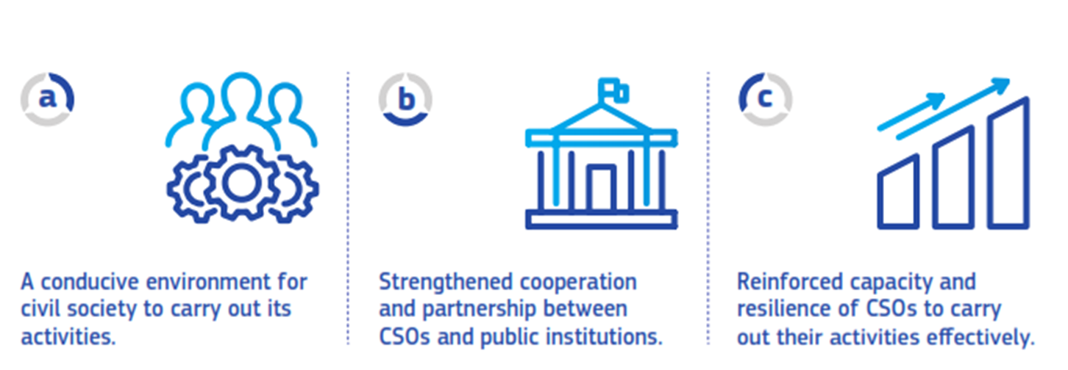
DG NEAR Guidelines: Three specific objectives

Slide 3
Methodology
Legal analysis
Document review
CSO survey
  908 valid responses (766 for 2021)
  Average margin of error within 10% at country level
Survey of public officials
  93 valid responses (76 for 2021)
9 focus groups (37 discussants), 14 interviews and 7 country validation sessions
Consistent application of methodology but some ratings adjusted in 2023
53 indicators reviewed and 36 indicators assessed

Slide 4
Q & A

Slide 5
SO1: A conducive environment for civil society to carry out its activities is in place
Deterioration in Bosnia and Herzegovina and Serbia; status quo elsewhere
CSOs generally free to solicit and receive funding
Public funding remains a challenge; low confidence of CSOs in transparency and fairness of public funding awards (15%, 12% in 2021)
Environment not conducive to volunteering

Slide 6
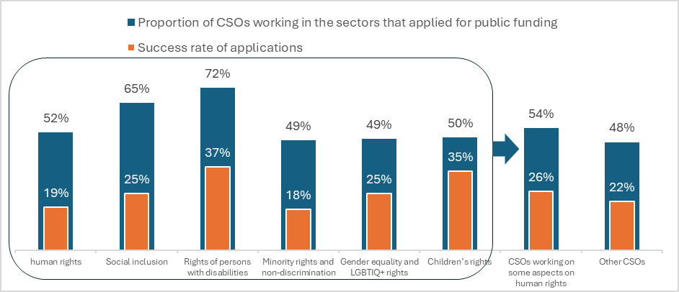

Slide 7
Q & A

Slide 8
SO2: Strengthened cooperation and partnership between CSOs and public institutions
Status quo with regard to inclusion of CSOs in decision- and policy-making processes; deterioration in Serbia
CSO perception of attitude of public officials negative (66%, 72% in 2021)
Civil society cooperation strategies in 5 countries (2 in 2021), however CSO confidence in them low (19%), and budgeted action plans available only in 3 countries
Mixed picture with civil society cooperation councils

Slide 9
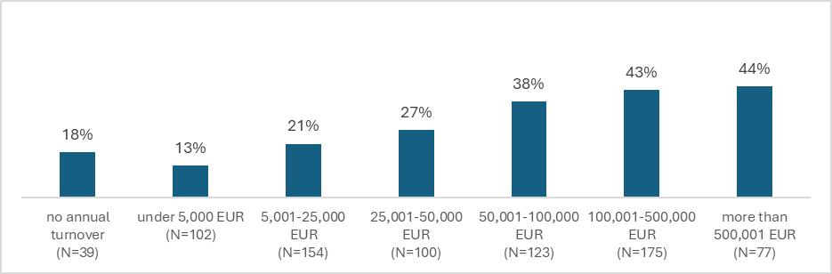

Slide 10
Proportion of CSOs indicating the attitude of public officials toward civil society as supportive
 | Albania | Bosnia and Herzegovina | Kosovo | Montenegro | North Macedonia | Serbia | Turkey | Total
2023 | 38% | 24% | 40% | 18% | 26% | 6% | 25% | 24%
2021 | 34% | 12% | 30% | 13% | 12% | 14% | 18% | 18%
change 2023-2021 | 4% | 12% | 10% | 5% | 14% | -8% | 7% | 6%

Slide 11
 | Albania | Bosnia and Herzegovina | Kosovo | Montenegro | North Macedonia | Serbia | Türkiye
strategy in place | Yes | No | Yes | Yes | Yes | Yes | No
Strategy rated as relevant and effective | 33% | n/a | 34% | 14% | 18% | 5% | n/a

Slide 12
Q & A

Slide 13
SO3: CSO capacity and resilience to carry out their activities effectively are reinforced
Continued good performance: strategic vision, channels of communication, evaluation, stakeholder consultation and research, diversification of funding, professional development of staff and volunteers
Improvement: independence of governing boards
Continuing challenges: checking conflict of interest, transparency, organisational policies
Across the region, public confidence in CSOs higher than in government, parliament, political parties, media and judicial institutions (but not police and military)

Slide 14
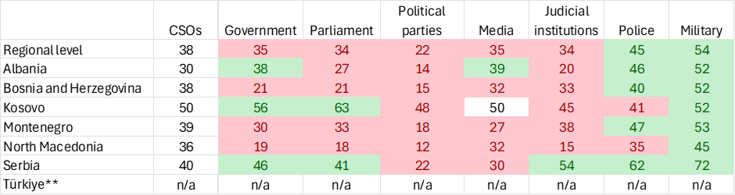

Slide 15
Q & A

